Slide 1
Group detection in Massive transportation system for GPS
SNUCSE Advanced Mobile Computing S19
Team 7

Slide 2
Contents
Background & Problem
Project Design
Project Goals

Slide 3
Background & Problem

Slide 4

Background
Everyone uses mobile device

Slide 5
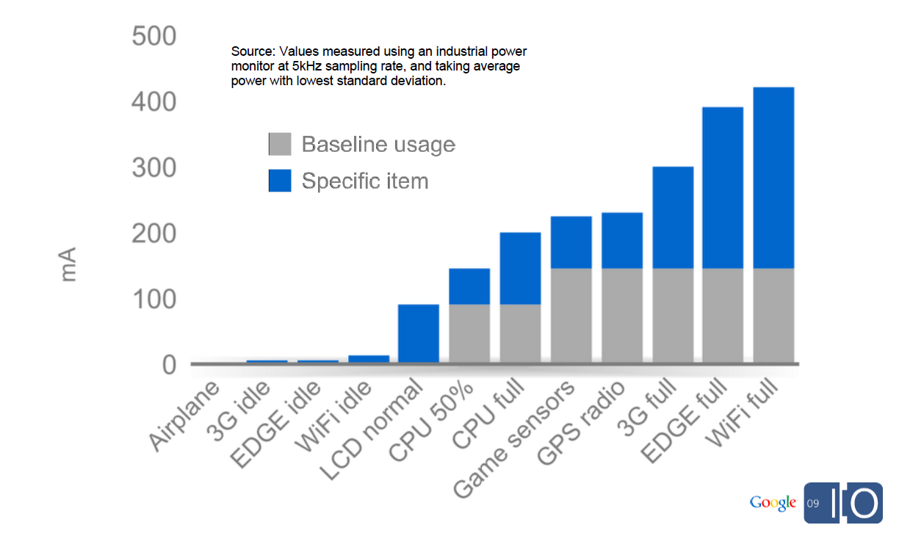
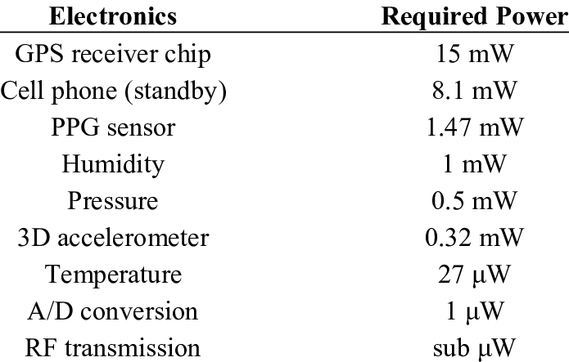
Background
GPS Sensing is expensive

Slide 6
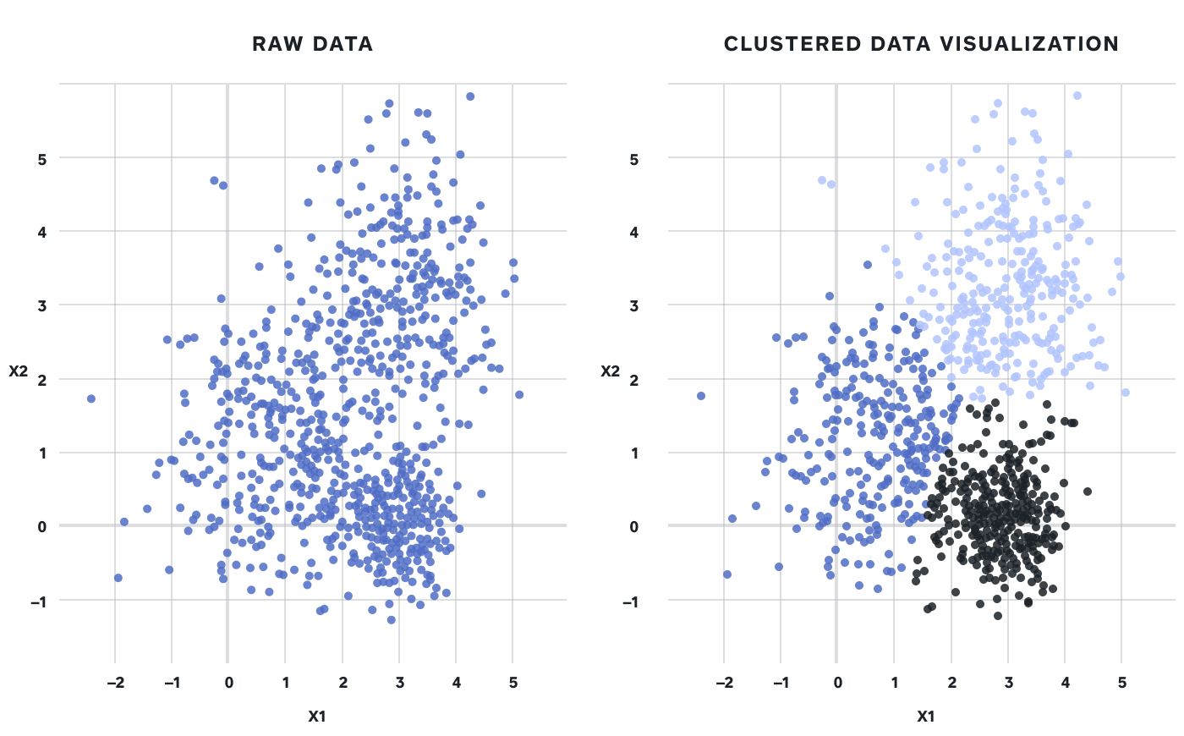
Background
Clustering is an essential way to analyze big data

Slide 7
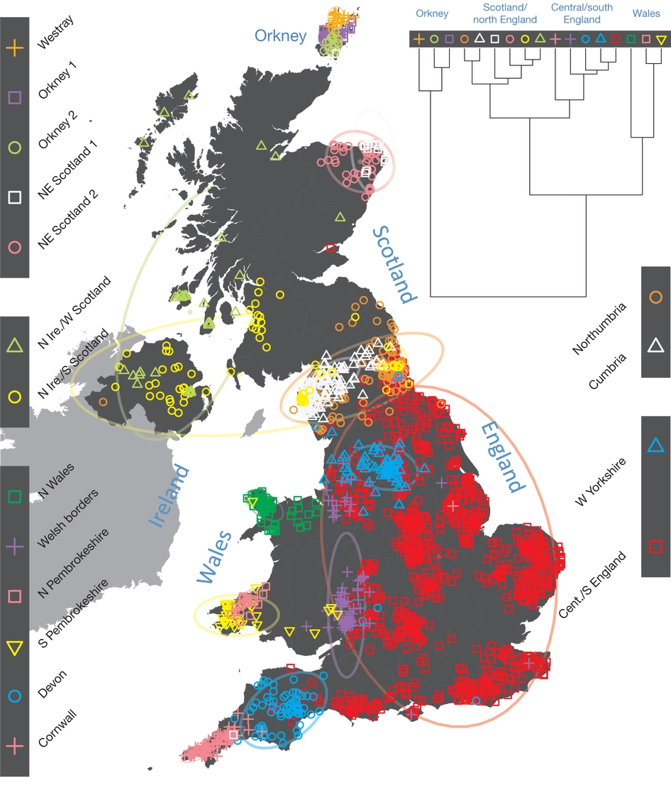

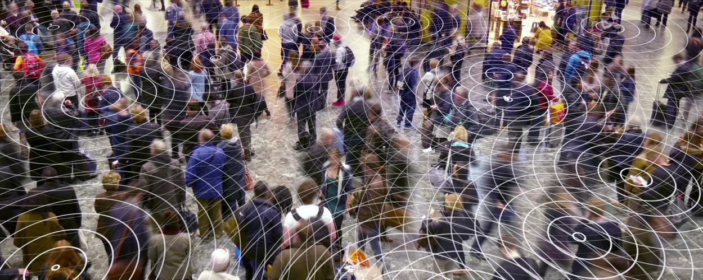
Problem
How to group signals to extract useful information
Notes:
Clustering a group from tons of signal is not a trivial problem. So we want to simplify this to make it solvable.

Slide 8
Project Design

Slide 9
Design Overview
Detected Group (Bus / Train / etc)
Efficient GPS Pipeline
User Signals

Slide 10
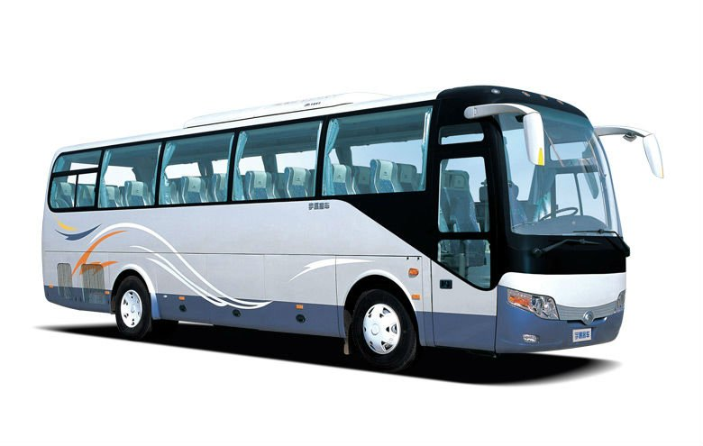
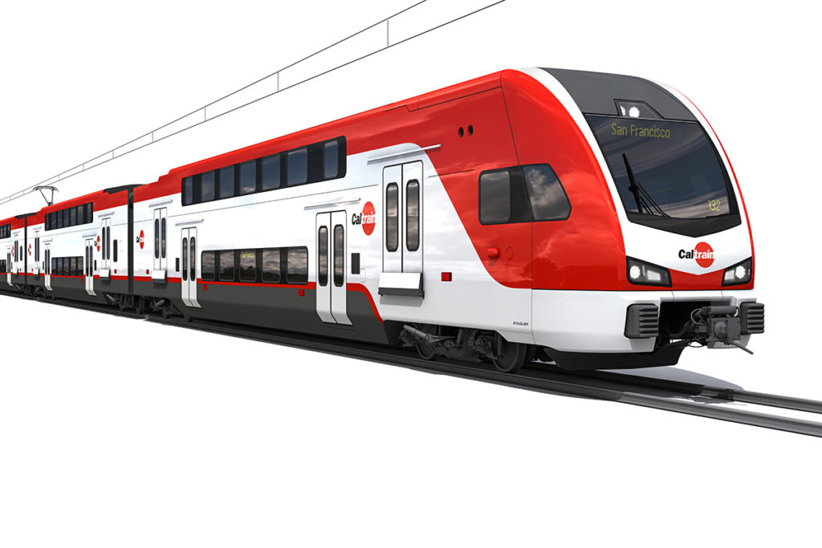
Details - How to find a group?
Movement-based sensors will detect similar signals from vehicles movement
Similar ambient signal for a certain time frame → Same vehicle

Slide 11
Details - Group detection algorithm
Normalize movement-based sensors
Initial matching via GPS / Bluetooth
User sends an anonymized GPS info to server
Server detects potential group candidates
Apply FFT to easily filter out an ambient signal
Similarity check for a certain time frame to detect a group
Do something useful with a detected group
Duty cycle for validation
Similarity check
GPS distance threshold

Slide 12
Details - What to do with a group?
Energy-wise
Calculate user offset (Initial / Duty cycle)
Only activate 1 user’s sensor
How to pick a user
Sequentially take turns
Based on battery life
Accuracy-wise
Activate multiple users sensor
Remove outlier
Interpolation

Slide 13
Project Goals

Slide 14
What are the things that we want to explore?
How much will it cost to find a group?
How precise is the grouping result?
Improvements in GPS Pipeline
Battery life
Accuracy
More usage of detected group in a massive transportation system

Slide 15
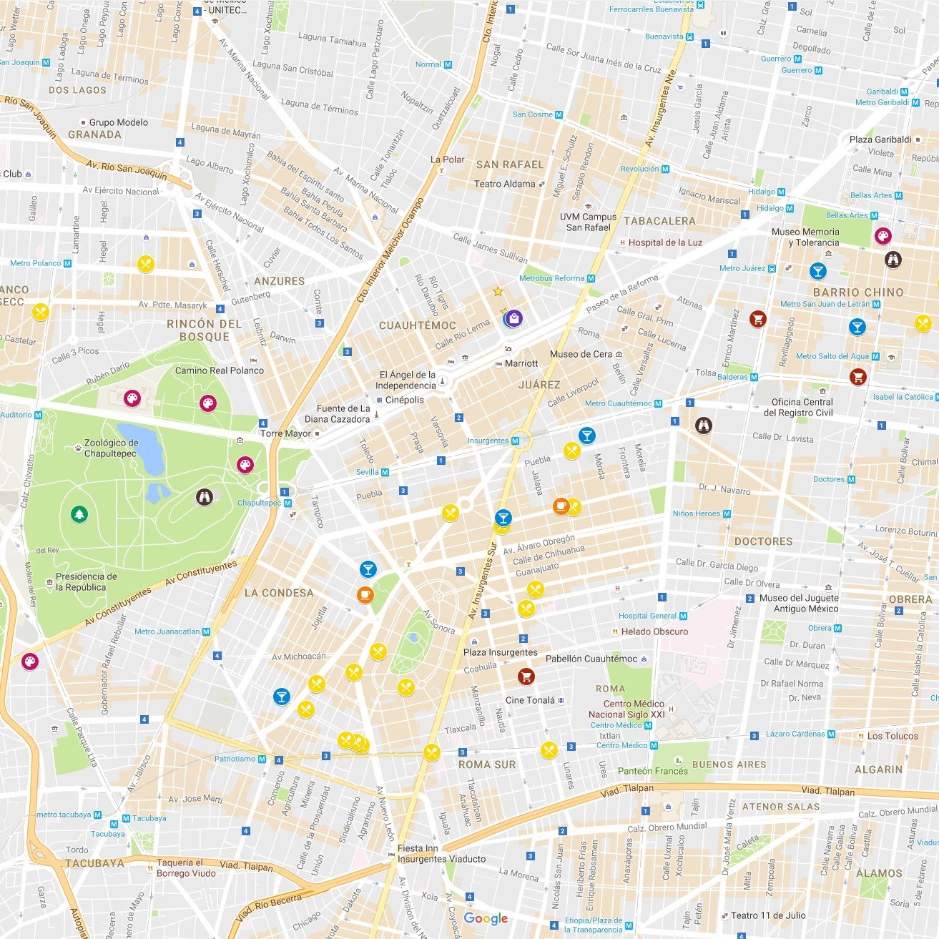
Project Goals per timeline
Ideal
Thin high-level layer on top of the GPS API
Midterm
Mockup Application
Manual grouping via Bluetooth / Network
Group visualization
GPS information sharing
Final
Automatic group matching
Duty cycle for group validity check
Evaluations
Battery usage
Accuracy (if possible)
Active Sensor
Inactive Sensor

Slide 16


